Slide 1
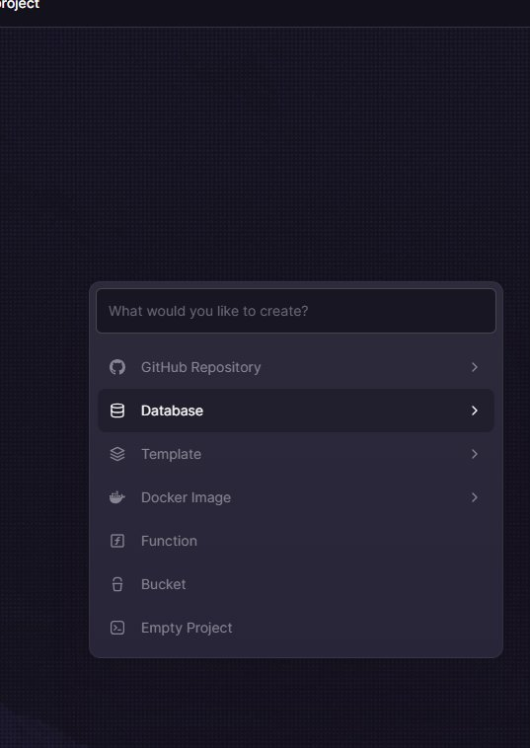
EN
WEEK 02
</>
Loops, Functions & Structures
Repeating actions and organising reusable code
By the end of this lesson you will be able to:
○ Write for and while loops to repeat code
○ Define and call your own functions with parameters
○ Understand when to use lists and how to loop through them
codencode.my
Python for Beginners • Week 02 — Loops, Functions & Structures
EN
01

Slide 2
The for Loop — Repeat for Each Item
📖 Iterating over a sequence
for_loop.py
A for loop runs a block of code once for each item in a sequence.
Common sequences:
○ range(5) → 0, 1, 2, 3, 4
○ range(1, 6) → 1, 2, 3, 4, 5
○ range(0,10,2) → 0, 2, 4, 6, 8
○ A list: ["apple","mango"]
○ A string: "Python"
Indentation matters! Everything indented under for: is part of the loop.
# Count using range
for i in range(5):
print("Count:", i)
# Loop over a list
fruits = ["apple", "mango", "durian"]
for fruit in fruits:
print("I like", fruit)
# Loop over a string
for letter in "Python":
print(letter, end=" ")
# P y t h o n
codencode.my
Python for Beginners • Week 02 — Loops, Functions & Structures
EN
02

Slide 3
Mastering range()
range_demo.py
# range(stop)
for i in range(5):
print(i, end=" ") # 0 1 2 3 4
# range(start, stop)
for i in range(1, 6):
print(i, end=" ") # 1 2 3 4 5
# range(start, stop, step)
for i in range(0, 20, 5):
print(i, end=" ") # 0 5 10 15
# Countdown with negative step
for i in range(10, 0, -1):
print(i, end=" ") # 10 9 8 7 6 5 4 3 2 1
# enumerate — get index AND item
students = ["Aisha", "Wei Jie", "Siti"]
for i, name in enumerate(students, 1):
print(f"{i}. {name}")
💡 What this does:
range(start, stop, step) is highly flexible. The stop value is always excluded. enumerate() gives you both the index and the item — perfect for numbered lists.
codencode.my
Python for Beginners • Week 02 — Loops, Functions & Structures
EN
03

Slide 4
The while Loop — Repeat Until False
📖 Condition-controlled repetition
while_loop.py
A while loop keeps running as long as its condition is True.
Use while when you don't know how many times to repeat — e.g. waiting for the right user input.
⚠️ Always change the condition inside the loop or you'll get an infinite loop!
break → exit the loop immediately
continue → skip to the next iteration
# Countdown
count = 5
while count > 0:
print(count)
count -= 1
print("Blast off! 🚀")
# Keep asking until correct
password = ""
while password != "secret123":
password = input("Password: ")
print("✅ Access granted!")
# break example
while True:
cmd = input("Enter 'quit' to stop: ")
if cmd == "quit":
break
print(f"You typed: {cmd}")
codencode.my
Python for Beginners • Week 02 — Loops, Functions & Structures
EN
04

Slide 5
Functions — Reusable Blocks of Code
functions.py
# Define a function
def greet(name):
print("Hello,", name + "!")
# Call the function
greet("Aisha") # Hello, Aisha!
greet("Wei Jie") # Hello, Wei Jie!
# Function with a return value
def add(a, b):
return a + b
total = add(10, 25)
print("Total:", total) # Total: 35
# Default parameter
def greet_lang(name, lang="EN"):
print(f"[{lang}] Hello, {name}!")
greet_lang("Siti") # [EN] Hello, Siti!
greet_lang("Ahmad", "BM") # [BM] Hello, Ahmad!
💡 What this does:
def declares a function. Parameters are inputs in brackets. return sends a value back — unlike print() which only shows on screen. Default parameters are used when no argument is passed.
codencode.my
Python for Beginners • Week 02 — Loops, Functions & Structures
EN
05

Slide 6
return vs print — Key Difference
📖 Functions that compute vs functions that display
return_vs_print.py
This confuses many beginners!
print() — shows text on screen. The value is gone. Cannot be stored, reused or passed to another function.
return — sends a value back to the caller. Can be stored in a variable, used in calculations, passed elsewhere.
Rule of thumb:
○ If you're showing info to the user → print()
○ If the value needs to be used later → return
A function can have both!
# print only — value is lost
def show_double(x):
print(x * 2)
show_double(5) # 10 (displayed)
result = show_double(5) # 10 (displayed)
print(result) # None ← gone!
# return — value is kept
def calc_double(x):
return x * 2
result = calc_double(5)
print(result) # 10
print(result + 3) # 13 ← reusable!
doubled = calc_double(7)
tripled = calc_double(doubled)
print(tripled) # 42
codencode.my
Python for Beginners • Week 02 — Loops, Functions & Structures
EN
06

Slide 7
Key Concepts — Loops & Functions
for
for loop
whl
while loop
Best when you know how many times to repeat, or you're going through a list, string, or range. Use enumerate() for index + item.
Best when you repeat until something changes — like waiting for correct user input or a condition to flip. Don't forget to change the condition!
def
Functions
ret
return vs print
def name(params): defines a reusable block. Call it by name. Keeps code DRY — Don't Repeat Yourself. Use default params for optional arguments.
print() only shows on screen — value is lost. return sends a value back to the caller so it can be stored, calculated with, or passed further.
codencode.my
Python for Beginners • Week 02 — Loops, Functions & Structures
EN
07

Slide 8
Lists — Storing Multiple Items
📖 Ordered, changeable collections
lists.py
A list stores multiple values in one variable.
Key operations:
○ Access by index: list[0] is first item
○ Negative index: list[-1] is last item
○ len(list) → number of items
○ list.append(x) → add to end
○ list.remove(x) → remove first occurrence
○ list.sort() → sort in place
○ list.pop() → remove and return last
Indexes start at 0, not 1!
scores = [85, 92, 78, 96, 61]
print(scores[0]) # 85 (first)
print(scores[-1]) # 61 (last)
print(len(scores)) # 5
# Add and remove
scores.append(88)
scores.remove(61)
print(scores)
# Loop through list
for s in scores:
print("Score:", s)
# Sort ascending
scores.sort()
print("Sorted:", scores)
codencode.my
Python for Beginners • Week 02 — Loops, Functions & Structures
EN
08

Slide 9
Useful List Methods
list_methods.py
names = ["Wei Jie", "Aisha", "Rajan", "Siti"]
# Slicing — get a portion
print(names[1:3]) # ['Aisha', 'Rajan']
print(names[:2]) # ['Wei Jie', 'Aisha']
print(names[2:]) # ['Rajan', 'Siti']
# Insert at position
names.insert(0, "Farid")
print(names) # Farid at front
# Find index
idx = names.index("Aisha")
print("Aisha is at index:", idx)
# Check membership
print("Siti" in names) # True
print("Ali" in names) # False
# Count occurrences
nums = [1, 2, 2, 3, 2]
print(nums.count(2)) # 3
# Reverse
names.reverse()
print(names)
💡 What this does:
Lists have many built-in methods. Slicing [start:stop] extracts a sub-list without modifying the original. 'in' checks if an item exists — useful in if conditions.
codencode.my
Python for Beginners • Week 02 — Loops, Functions & Structures
EN
09

Slide 10
Combining Loops, Lists & Functions
combined.py
def get_grade(score):
if score >= 90: return "A"
elif score >= 75: return "B"
elif score >= 60: return "C"
else: return "F"
def average(marks):
return sum(marks) / len(marks)
def print_report(names, scores):
print("── Class Report ──")
for name, score in zip(names, scores):
grade = get_grade(score)
print(f" {name:<10} {score:>3} → {grade}")
avg = average(scores)
print(f"
Class Average: {avg:.1f}")
names = ["Aisha","Wei Jie","Siti","Rajan","Farid"]
scores = [92, 78, 65, 88, 55]
print_report(names, scores)
💡 What this does:
zip() pairs two lists together — perfect for matching names with scores. f-string format codes like {name:<10} left-align in 10 chars; {score:>3} right-aligns in 3.
codencode.my
Python for Beginners • Week 02 — Loops, Functions & Structures
EN
10

Slide 11
🧠 Quiz Time!
Q:
What will this code print?
for i in range(2, 8, 2):
print(i)
A
2 3 4 5 6 7
B
2 4 6
C
2 4 6 8
D
0 2 4 6
codencode.my
Python for Beginners • Week 02 — Loops, Functions & Structures
EN
11

Slide 12
List Comprehension — Pythonic Shorthand
comprehension.py
# The long way
squares = []
for i in range(1, 6):
squares.append(i ** 2)
print(squares) # [1, 4, 9, 16, 25]
# The Pythonic way — list comprehension
squares = [i ** 2 for i in range(1, 6)]
print(squares) # [1, 4, 9, 16, 25]
# With condition
evens = [i for i in range(20) if i % 2 == 0]
print(evens) # [0, 2, 4, 6, 8, 10, 12, 14, 16, 18]
# Transform a list
names = ["aisha", "wei jie", "siti"]
proper = [n.title() for n in names]
print(proper) # ['Aisha', 'Wei Jie', 'Siti']
# Filter scores
scores = [82, 45, 91, 60, 33, 77]
passed = [s for s in scores if s >= 60]
print(passed) # [82, 91, 60, 77]
💡 What this does:
List comprehensions build a new list in a single line: [expression for item in iterable if condition]. They're more readable and faster than a loop + append. Very popular in real Python code.
codencode.my
Python for Beginners • Week 02 — Loops, Functions & Structures
EN
12

Slide 13
⌨️ Try It Yourself
📋 Build a Class Grade Report
🏆 XP Reward
1. Create a list of 5 student names and a list of 5 scores
2. Write a function get_grade(score) that returns A / B / C / F
3. Use zip() and a for loop to print each student's name, score, and grade
4. Calculate and print the class average using a function
5. Bonus: Use a list comprehension to get a list of students who passed (score >= 60)
60 XP
⏱ Time Limit
20 min
Expected output:
Aisha : 92 → A
Wei Jie : 78 → B
Siti : 65 → C
Rajan : 88 → B
Farid : 55 → F
Average : 75.6
Passed : ['Aisha','Wei Jie','Siti','Rajan']
codencode.my
Python for Beginners • Week 02 — Loops, Functions & Structures
EN
13

Slide 14
⌨️ Try It Yourself
📋 Bonus Task: Number Guessing Game
🏆 XP Reward
1. Pick a secret number between 1 and 20 (hardcode it for now)
2. Use a while loop to keep asking the user to guess
3. After each guess, print 'Too high!', 'Too low!', or 'Correct!'
4. Count the number of attempts and print it when the user wins
5. Bonus: Add a maximum of 7 attempts — if exceeded, reveal the answer
40 XP
⏱ Time Limit
15 min
Expected output:
Guess (1-20): 10
Too low!
Guess (1-20): 15
Too high!
Guess (1-20): 13
Correct! in 3 attempts 🎉
codencode.my
Python for Beginners • Week 02 — Loops, Functions & Structures
EN
14

Slide 15
Lesson Summary
✅ What we learned today
🔍 Next Week
○ for loops iterate over sequences or a range of numbers
Week 3: File Handling & Error Control
We'll learn how to read and write files, and use try/except to handle errors gracefully.
○ while loops repeat until a condition becomes False
○ Functions let you name and reuse a block of code
○ return sends a value back; print() only displays
○ Lists store multiple values — use append, sort, zip, enumerate
📝 This Week's Assignment
100 XP
Write a grade report program for 5 students. Use a function for grading, zip() for pairing, and list comprehension for passed students. Submit your .py file.
codencode.my
Python for Beginners • Week 02 — Loops, Functions & Structures
EN
15

